Slide 1

Fantasy Saga D-Type
B y TwilightRaven Games
Friday, July 20, 2012

Slide 2
Fantasy Saga D-Type
An Action Role Playing Game
For PC, Mac OS X, iPhone, and Xbox 360

Slide 3
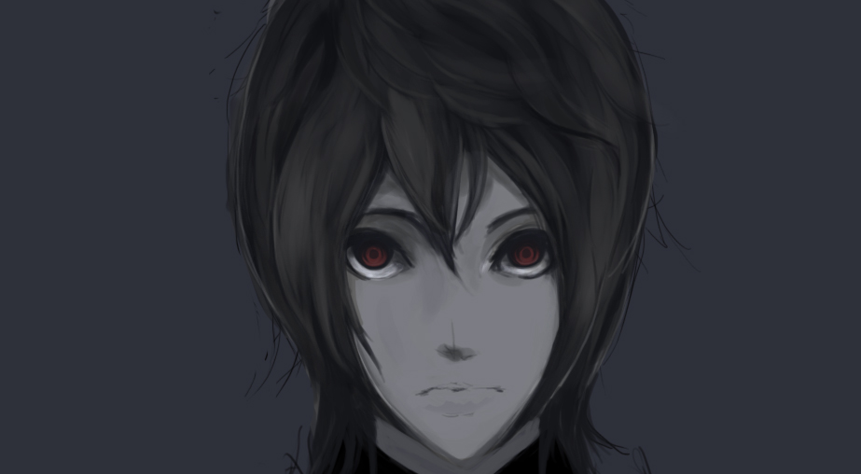
Some concept art…

Slide 4
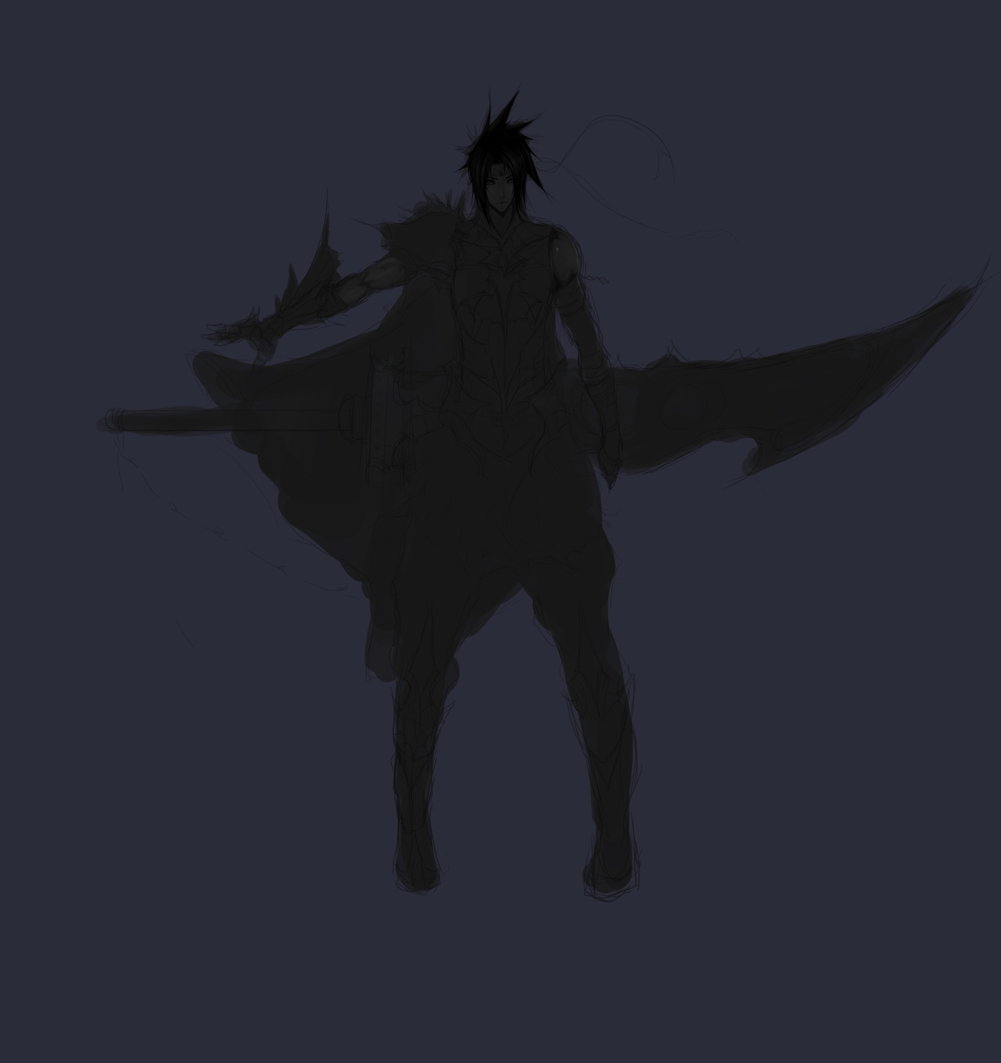
Some concept art…

Slide 5
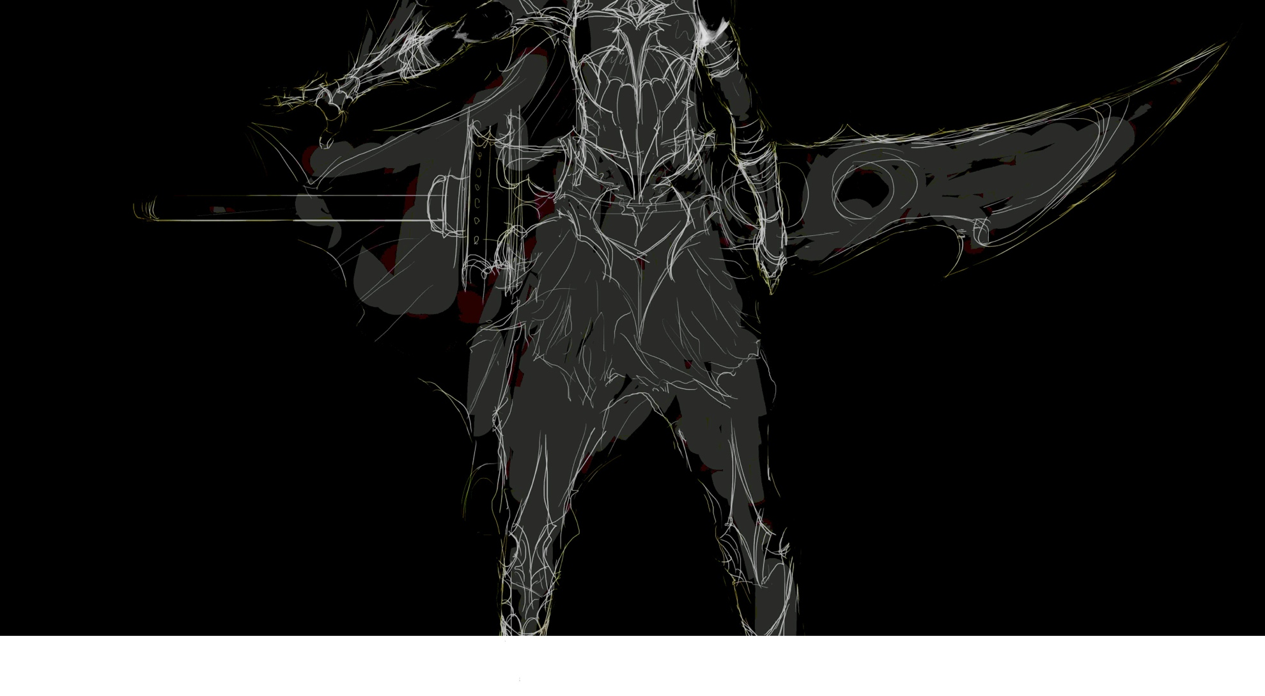
Seren “Lit Up”

Slide 6
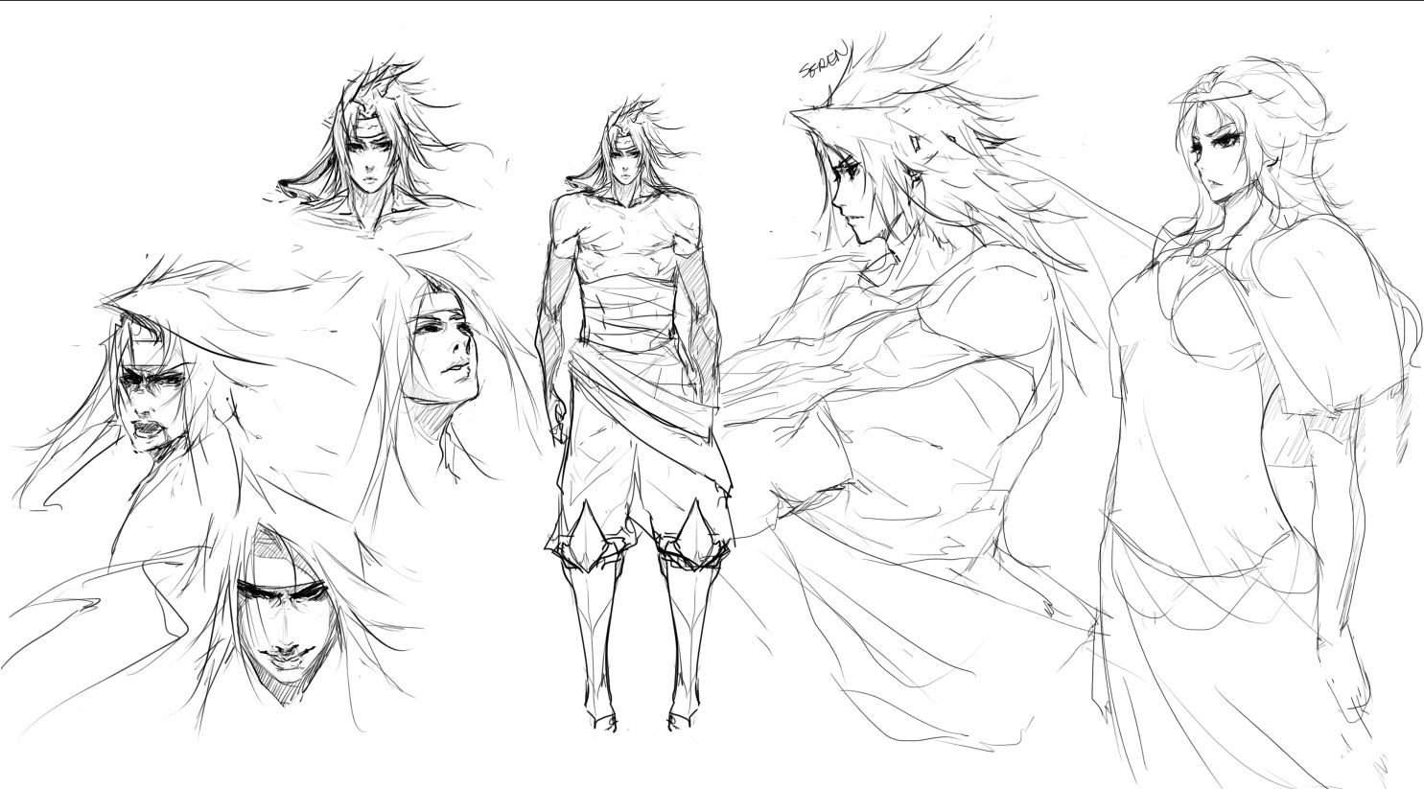
More of Seren and Ariel

Slide 7
Pixel Art

Slide 8

Pixel Art

Slide 9
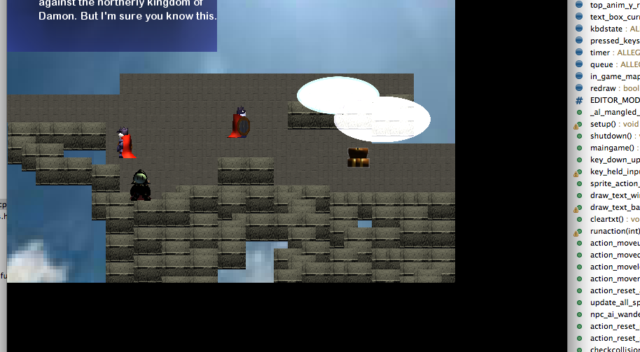
Game Demo so far….

Slide 10
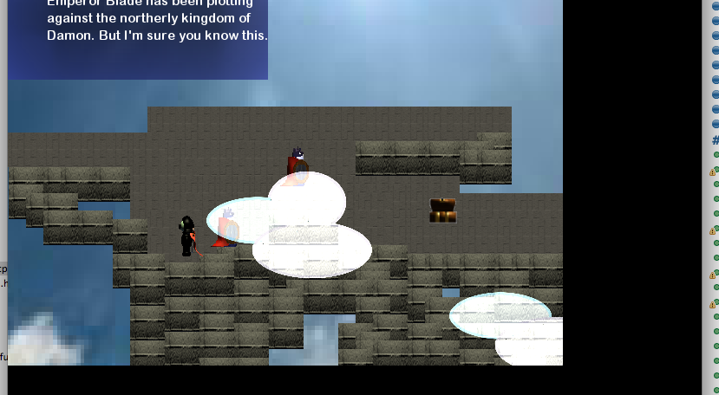
Game Demo So Far…

Slide 11
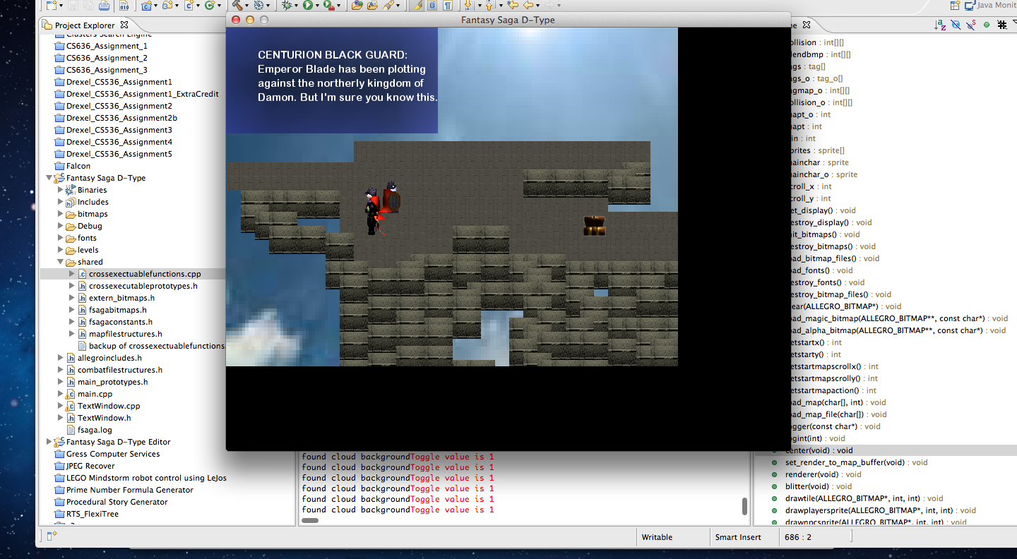
Game Demo So Far…

Slide 13
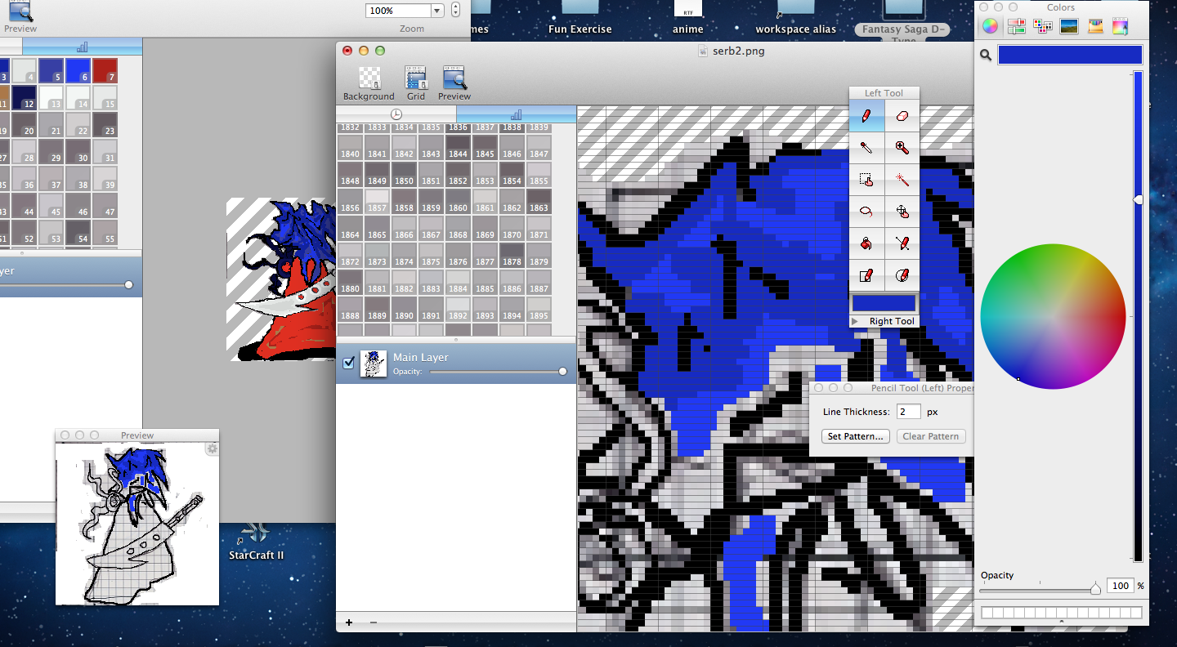
Game Art in Progress

Slide 14
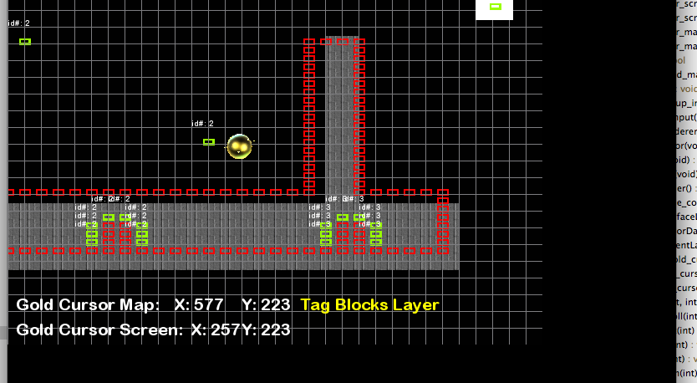
Game in Editing

Slide 15
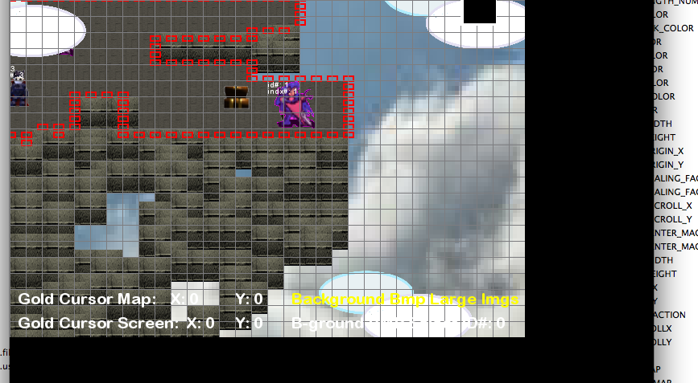
Game in Editing Continued…

Slide 16
Check out Fantasy Saga D-Type and other games at
Follow us and share..
Web: http://www.twilightraven.com
Twitter: @TwilightRavenGr
Blogspot: twilightravengames.blogspot.com
FaceBook: https://www.facebook.com/TwilightRavenDevelopment

Slide 17
Contribute and Help Fund Us!!
Help fund us on Indiegogo: http://igg.me/p/174066?a=882762
Help fund us Kickstarter too!

Slide 18
Contact
Twilight Raven Contact: admin@twilightraven.com
Me (Walter Gress)
ted_gress@yahoo.com

Slide 19
Credits
Programming and Artwork: Walter Gress
Concept and Character Art: Will
Music by Bright Eyes, “Coat Check Dream Song”

